Slide 1

HW #1: SuperCollider FM Synth
Group:
Group: Radical Geeks
Components:
Gerardo Cicalese (ID: 10776504)
Alberto Bollino (ID: 10865248)
Umberto Derme (ID: 10662564)
Giorgio Granello (ID: 10869436)
Computer Music - Languages and Systems
Homework 1 - Supercollider

Slide 2
HISTORY
OVERVIEW OF FM SYNTHS
Invented by John Chowning while he was experimenting with vibrato at Stanford University.
FM EQUATION
We have two oscillators, A₁ (the modulator) and A₂ (the carrier), described by the equations:
A₁ (t) = a₁ cos(ω₁ t)
A₂ (t) = a₂ cos((ω₂ + A₁ (t)) t)
As we can see, the input of the carrier is the output of the modulator, so:
A₂ (t) = a₂ cos((ω₂ + a₁ cos(ω₁ t)) t)

Slide 3
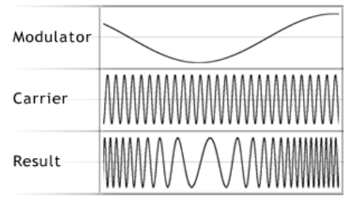
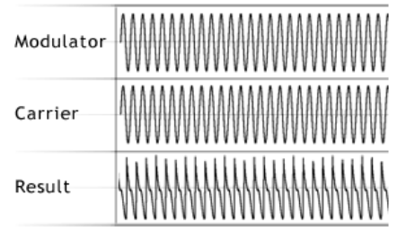
FM IN THE TIME DOMAIN
The figure on the top right shows what happens to the carrier while its frequency is being swept up and down by a modulator.
The figure on the bottom right shows what happens when the modulator’s frequency approaches, equals, or even exceeds that of the carrier: the modulation will become a form of distortion within the individual cycles of the carrier waveform.

Slide 4
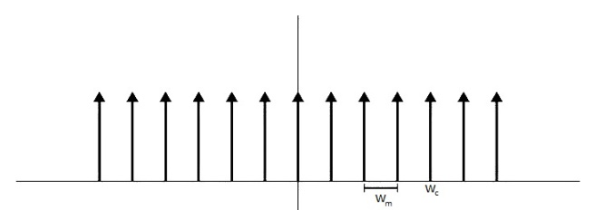
FM IN THE FREQUENCY DOMAIN
Let’s analyze the effect of the FM on the modulator frequency (ω_{m}):
FM generates side bands, that are represented by the following equation:
ω_{sb} = ω_{c} ± nω_{m} (n from 0 to ∞)
In theory, applying FM to a signal produces an infinite series of side bands.

Slide 5
MODULATION INDEX
We define the modulation index as: β = ∆ω_{c}/ω_{m}
The modulation index determines the amplitude of each of the components in the spectrum of the output signal.
β < 0.1 → significant sidebands will be the closest to the carrier frequency
β > 5 → we have a much broader series of side bands
CARRIER: MODULATOR RATIO
Let’s define the C:M Ratio (relative frequencies of carrier and modulator)
Now we can say that the frequencies of the upper side bands lie at C ± M, C ± 2M, C ± 3M, C ± 4M,...

Slide 6
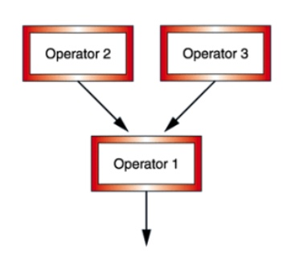
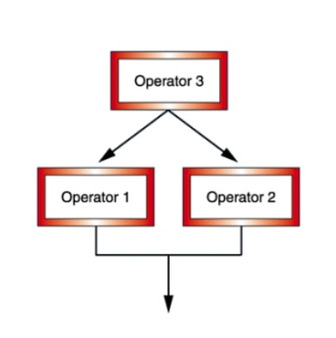
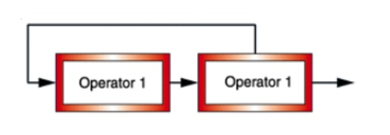
FM SYNTH ARCHITECTURES
Let’s see all the basic routings (operators connections):
An operator affecting one or more operators
An operator affected by no operator or one or more operators
An operator affected by the output of an operator in the same forward chain
An operator affecting two operators.
An operator affected by two operators.
An operator affected by the output of an operator in the same forward chain.

Slide 7
MODULATOR
A modulator consists of a sinusoidal oscillator with frequency ω_{m} + ∆ω_{m}, where:
ω_{m} : the unmodulated frequency of oscillation:
ω_{m} = (C : M) ⁻ ¹ · f₀
Where f₀ corresponds to the frequency corresponding to the note currently played
∆ω_{m} = f_{in} : the frequency sweep
Where f_{in} : the input to the modulator (if present)
Output → mono; is multiplied by a simple percussive envelope (user can change attack and release durations)
Gain → index β times the center frequency (A_{max} = β · ω_{m})

Slide 8
CARRIER
The carrier is basically an oscillator, which waveform can be:
Sinusoidal
Triangle wave
Sawtooth wave
The user can control the following parameters:
Frequency
Envelope
Panning
Gain

Slide 9
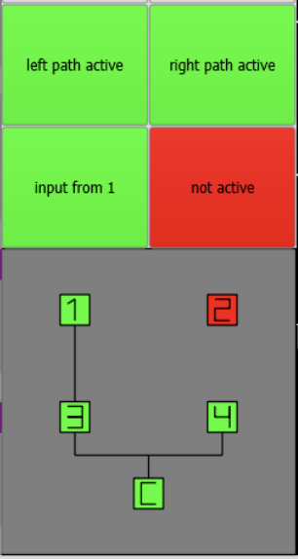
TOPOLOGY (ALGORITHM) OF THE SYNTH
The user can choose how to connect every operator to each other.
There are two different paths in parallel, each one with two operators.
The output of the two paths is mixed and sent to the carrier.
The user has the option of backpropagating the output of the carrier to the input of the modulators.
As an example, let’s consider the figure on the left:
Both paths are active
On the right path, only the last operator is enabled

Slide 10
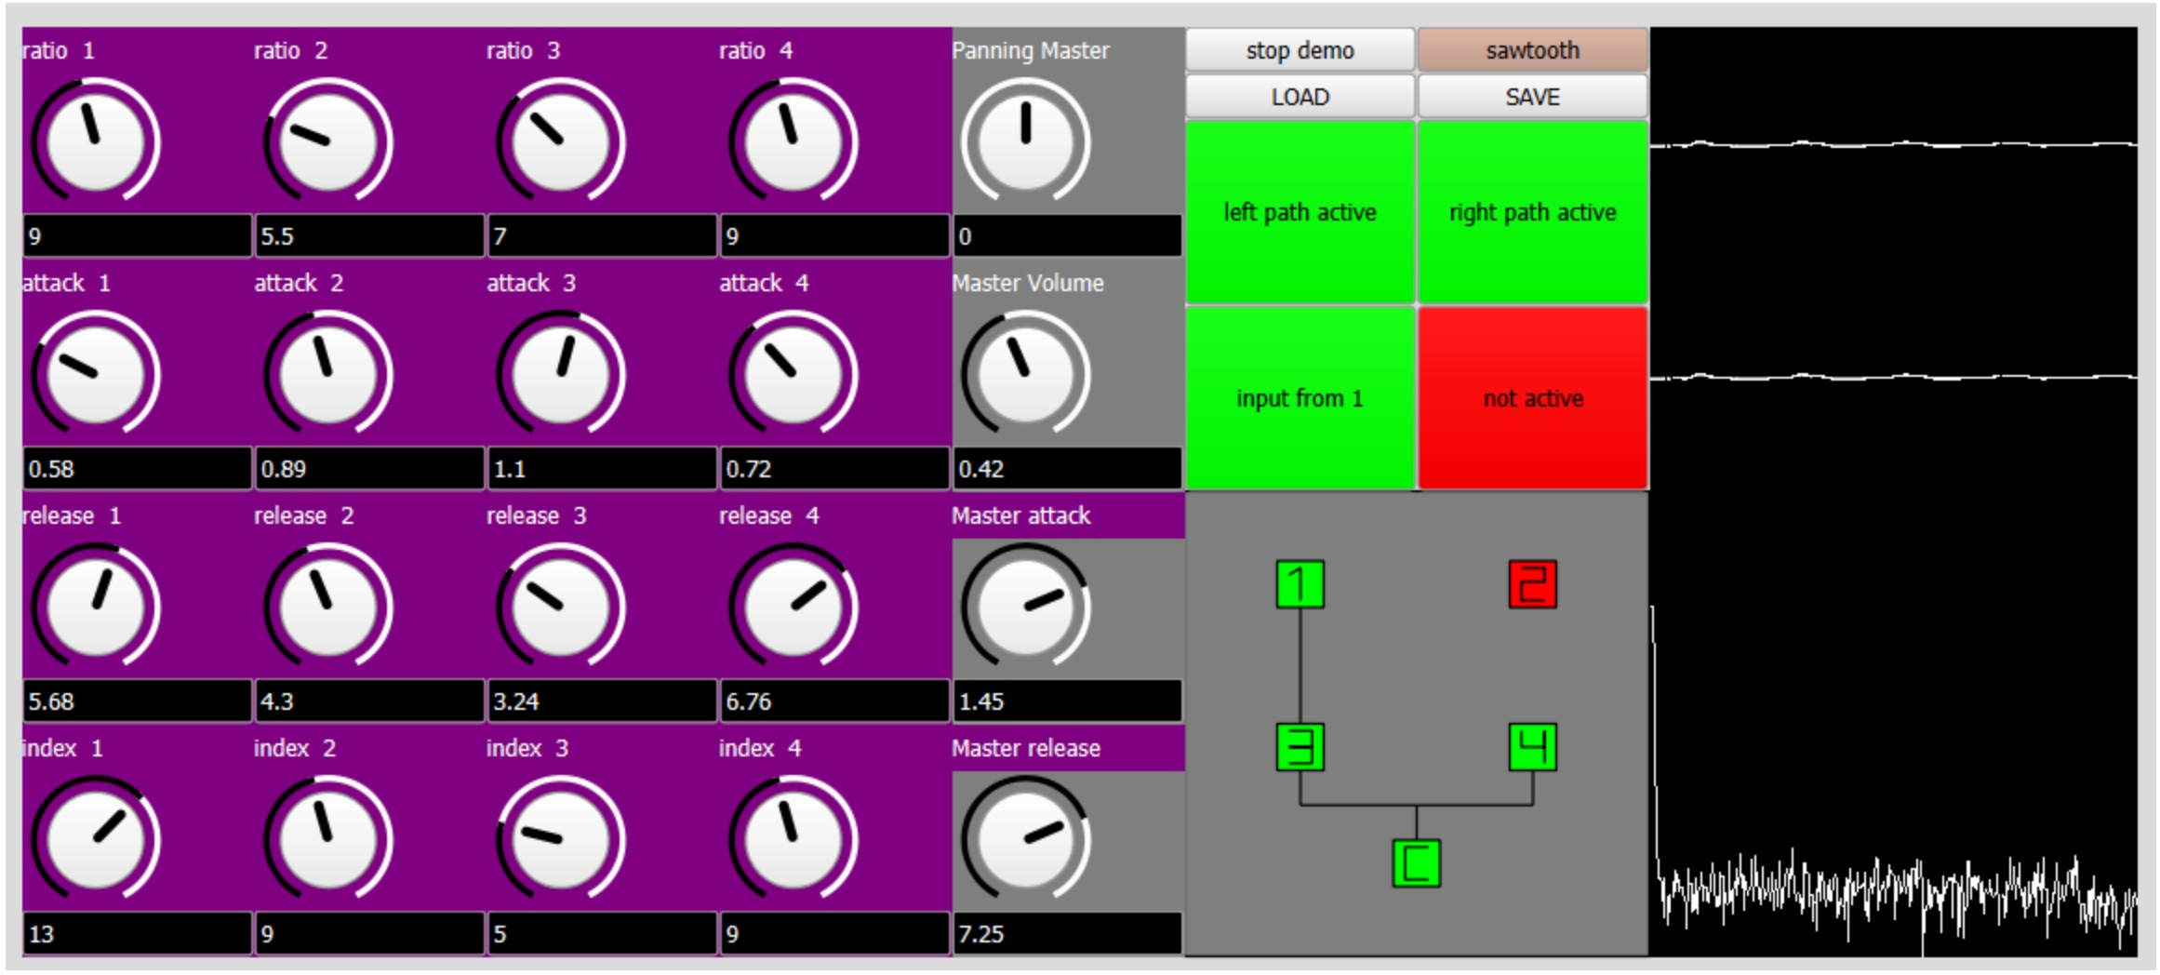
GUI
Our FM synth is designed to be easy to use
The user can play the synth thanks to a midi keyboard
By interacting with the knobs, he can configure the FM parameters
There are also a scope and a frequency scope windows on the right of the GUI, to let the user understand better the sound he’s creating

Slide 11
DEMO

Slide 12
THANKS FOR YOUR ATTENTION

